Slide 1


JAVA PROJECT (MAD-3463_2)
Team-7 Members:
Ankit Sharma (C0770025)
Ankur Sahni (C0774585)
Kshitij Pokhriyal (C0771607)
Rajinder Kaur (C0779393)

Slide 2
OVERVIEW
Team Name: Debuggers
Project name: Advanced Calculator
Project type: Console-based application
Concepts in use:
Object oriented programming
Conditional structure
Exception handling
Swings extension library

Slide 3


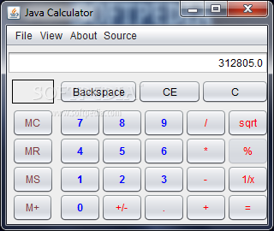
Advanced Calculator

Slide 4
Explanation about the project…
Advanced calculator is a system used to quickly access certain mathematical functions, particularly those that need to be looked up in mathematical tables.
Using this calculator, you can find the logarithm of a number, raise to a power of 2 or 3, find a root square and cube root moreover the factorial of any number.
It supports calculations such as trigonometric functions like sine, cosine and tangent, and make the calculation process easy.

Slide 5
Features about Project
Scientific Notation
Floating-point arithmetic
Logarithmic functions
Trigonometric functions
Roots beyond the square root.

Slide 6
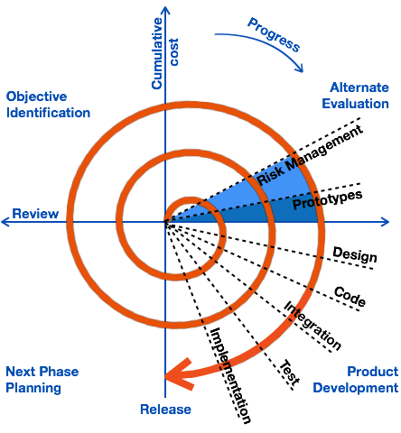
SDLC : Spiral Model
For this project the Software Development Life Cycle (SDLC) Model that we found suitable to follow was Spiral Model.
The spiral model has four phases. Our software project repeatedly passes through these phases in iterations called Spirals.

Slide 7
Spiral Model Implementation
Identification: This involves gathering all the requirements like business, system, subsystem and unit requirements.
Design: This phase includes conceptual design, architectural design, logical design of modules, physical product design and the final design in the subsequent spirals.
Construct: It produces actual software product at every spiral and with higher clarity on requirements and design in each subsequent spiral working model of the software improves.
Evaluation and Risk Analysis: It includes identifying, estimating and monitoring the technical feasibility and management risks, such as schedule slippage .
At the end of every phase the customer feedback is taken and based on that, the software development process enters the next iteration and subsequently follows the linear approach to implement the feedback suggested by the customer. The process of iterations along the spiral continues throughout the life of the software.

Slide 8
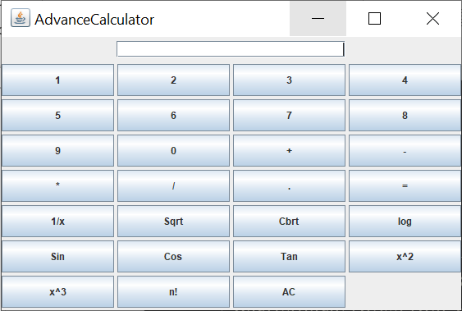
Design of the project

Slide 9
Functions of the standard buttons
[ 0 ], [ 1 ], [ 2 ], ... [ 9 ] : standard numeric keys
[ + ] : addition
[ - ] : subtraction
[ * ] : multiplication
[ / ] : division
[ . ] : decimal
[ = ] : to get the result
[ AC ] : reset the calculator
[ 1/x ] : inverse of a number
[ sin ] : sine
[ cos ] : cosine
[ tan ] : tangent
[ log ] : natural logarithm (to the base e)
[ x^2 ] : raises X to the power of 2
[ x^3 ] : raises X to the power of 3
[ sqrt ] : square root
[ cbrt ] : cube root
[ n! ] : factorial of a number

Slide 10
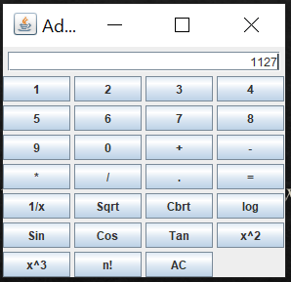
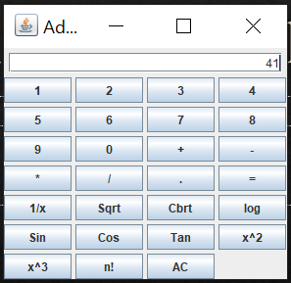
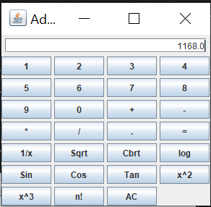
Testing for addition
First number: 1127
Second number: 41
Sum: 1127+41=1168

Slide 11
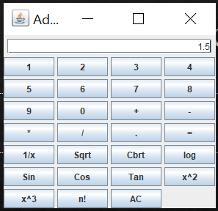
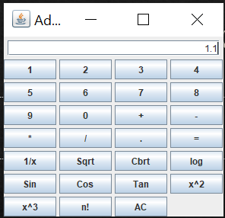
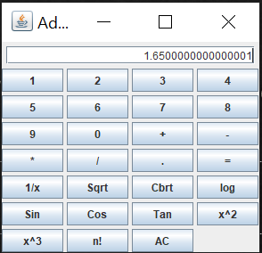
Testing for multiplication
First number: 1.5
Second Number: 1.1
Result: 1.5*1.1=1.65

Slide 12
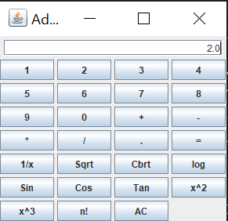
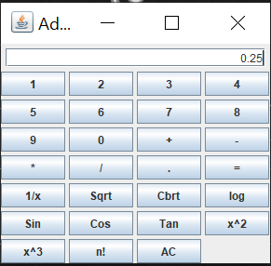
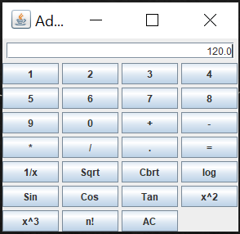
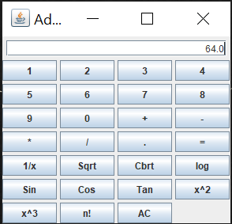
Testing other functions
Cube root of 8 = 2
Value of ¼ = 0.25
Square of 8 = 64
Factorial of 5 = 120

Slide 13
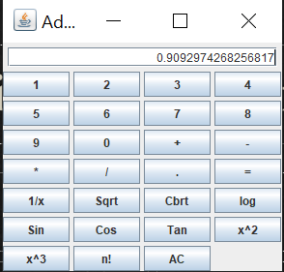
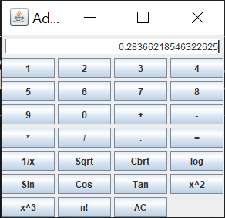
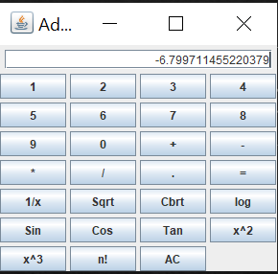
Testing for Trigonometric Functions
Sin 2
Cos 5
Tan 8

Slide 14
Conclusion
Our project successfully calculates the basic trigonometric, logarithmic(base e) functions with high accuracy.
The results having decimal notation or negative values are also supported by this calculator.

